Slide 1

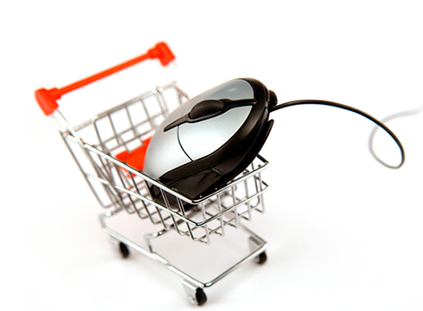
E-COMMERCE WEBSITE SHOPME

Slide 2

Presentation for e-commerce website

Slide 3

Introduction to the Shop Me App
Shop Me is a cutting-edge mobile application that revolutionizes the way you shop. With its intuitive interface and powerful features, Shop Me empowers you to discover, compare, and purchase products seamlessly from the palm of your hand.

Slide 4
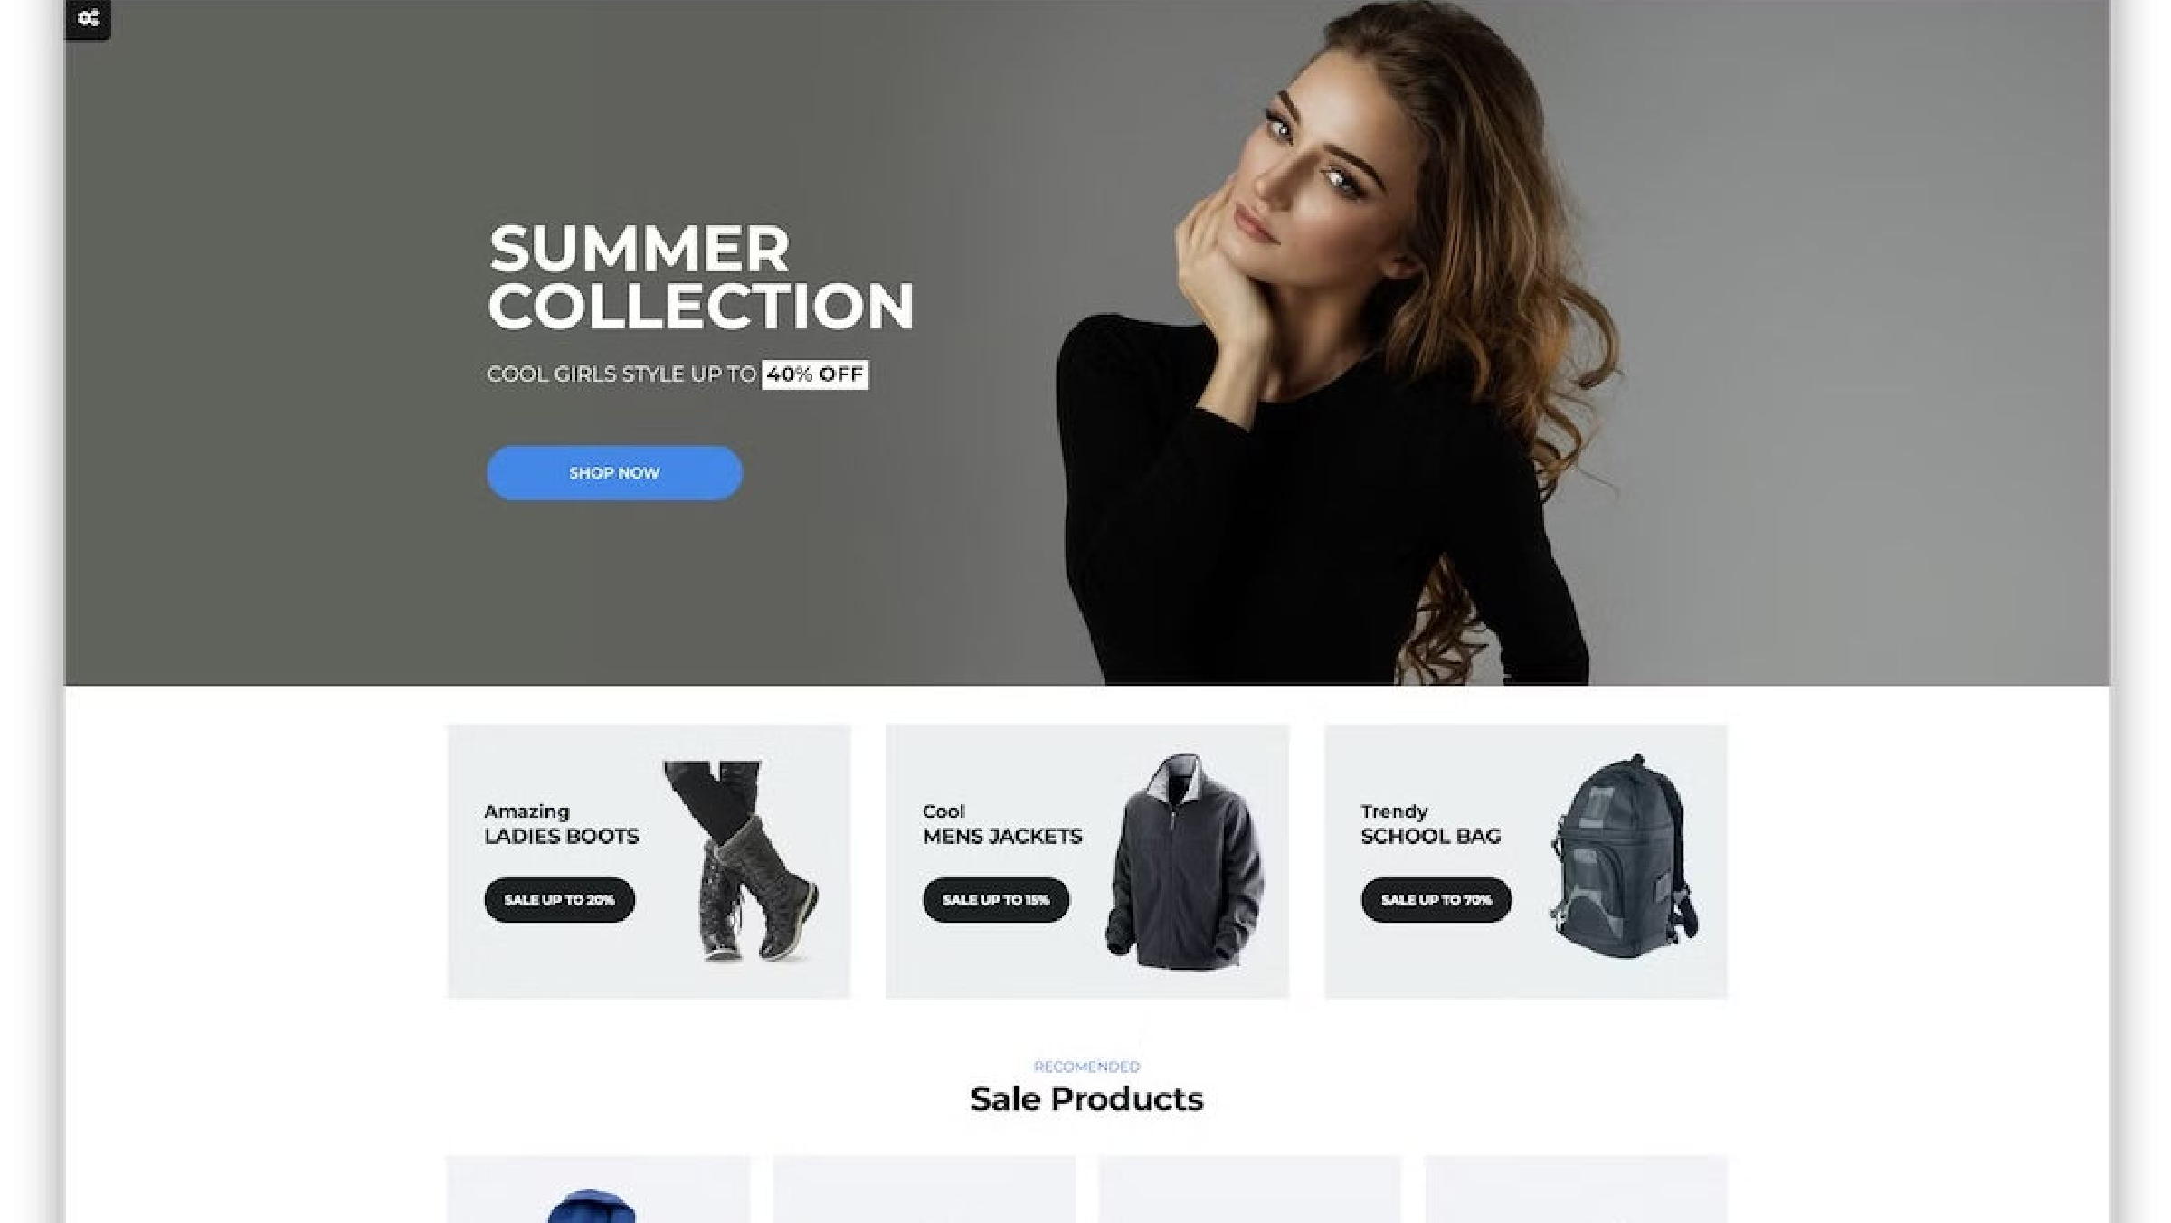
Abstract
The business-to-consumer aspect of product commerce (e-commerce) is the most visible business use of the World Wide Web. The primary goal of an e-commerce site is to sell goods online. This project deals with developing an e-commerce website for Online Product Sales. It provides the user with a catalog of products available for purchase in the store. In order to facilitate online purchase a shopping cart is provided to the user. The system is implemented using a 3-tier approach, with a backend database, a middle tier and a web browser as the frontend.

Slide 5
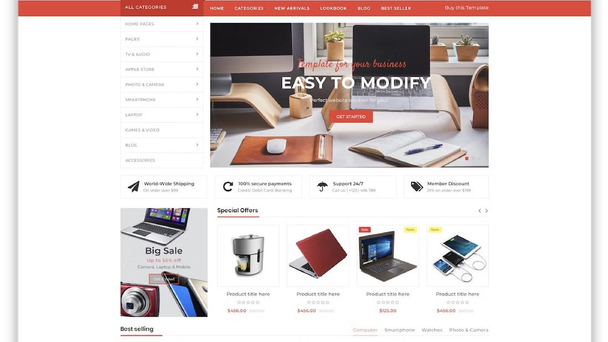
Abstract
These include multi-tiered architecture, server and client side scripting techniques, and implementation technologies such as PHP(OOP), JQUERY, BOOTSTRAP, HTML5, and relational databases (such as MySQL, Access). This project aims to develop a basic website where a consumer is provided with a shopping cart application and also to know about the technologies used to develop such an application. This document will discuss the underlying technologies to create and implement an e-commerce website.

Slide 6
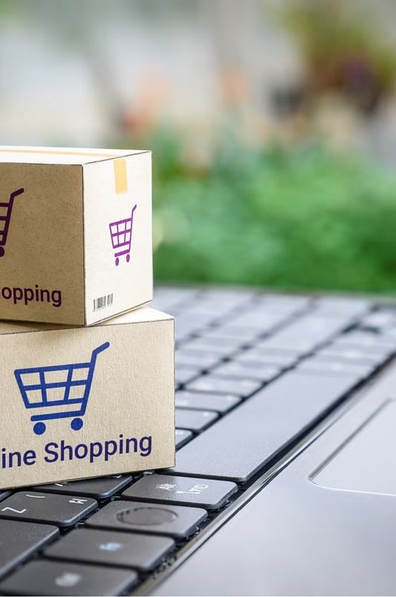
INTRODUCTION
E-commerce is fast gaining ground as an accepted and used business paradigm. More and more business houses are implementing websites providing functionality for performing commercial transactions over the web. It is reasonable to say that shopping on the web is becoming commonplace.
The objective of this project is to develop a general-purpose e-commerce store where any product can be bought from the comfort of home through the Internet. However, for implementation purposes, this paper will deal with online shopping for electronic product.
An online store is a virtual store on the Internet where customers can browse the catalog and select products of interest. The selected items may be collected in a shopping cart. At checkout time, the items in the shopping cart will be presented as an order.

Slide 7
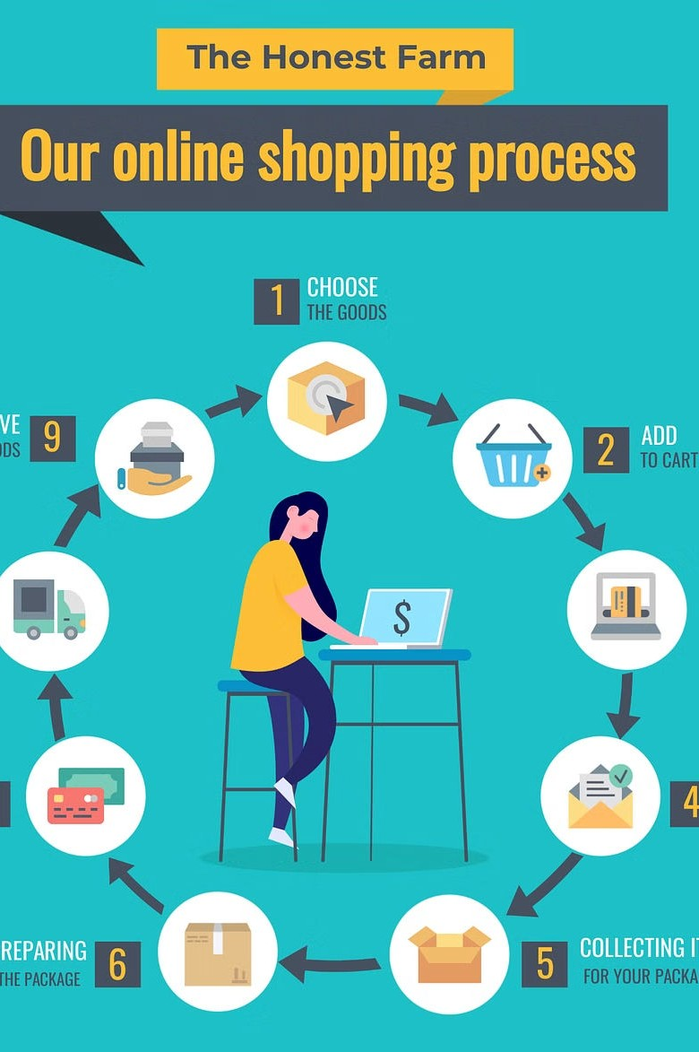
INTRODUCTION
At that time, more information will be needed to complete the transaction. Usually, the customer will be asked to fill or select a billing address, a shipping address, a shipping option, and payment information such as bKash, or Cash on Delivery. An e-mail notification is sent to the customer as soon as the order is placed.

Slide 8
Project Description
Admin: The mastermind behind the scenes, ensuring everything runs like clockwork on the website.
SalesPersom: The charming face of the company, wooing customers and sealing the deals with Indian hospitality.
Editor: The wordsmith wizard, weaving magic with words to entice customers into making purchases.
Shipper: The logistics guru, making sure orders reach customers' doorsteps across the vast expanse of India.
Assistant: The jack-of-all-trades, ready to lend a hand wherever needed to keep the online store running smoothly.
Any member can register and view available products.
Only registered member can purchase multiple products regardless of quantity. Contact Us page is available to contact Admin for queries.
There are four roles available:

Slide 9
Project Description
Admin: The mastermind behind the scenes, ensuring everything runs like clockwork on the website. SalesPerson: The charming face of the company, wooing customers and sealing the deals with Indian hospitality. Editor: The wordsmith wizard, weaving magic with words to entice customers into making purchases. Shipper: The logistics guru, making sure orders reach customers' doorsteps across the vast expanse of India. Assistant: The jack-of-all-trades, ready to lend a hand wherever needed to keep the online store running smoothly.

Slide 10
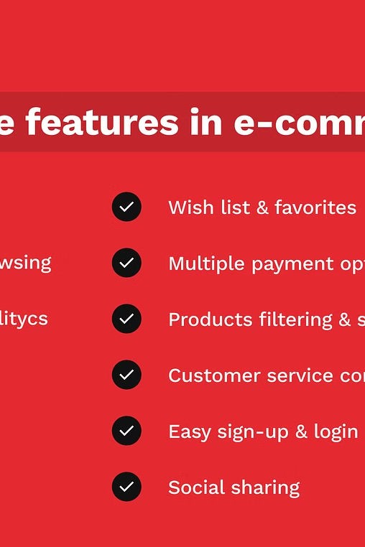
Key Features
Personalized Recommendations - Shop Me uses advanced algorithms to provide tailored product suggestions based on your browsing history and preferences.
Comparison Tool - Easily compare prices, reviews, and specifications across multiple retailers to find the best deals.
Secure Checkout - Enjoy a frictionless and secure checkout process with multiple payment options, including mobile wallets and digital currencies.

Slide 11
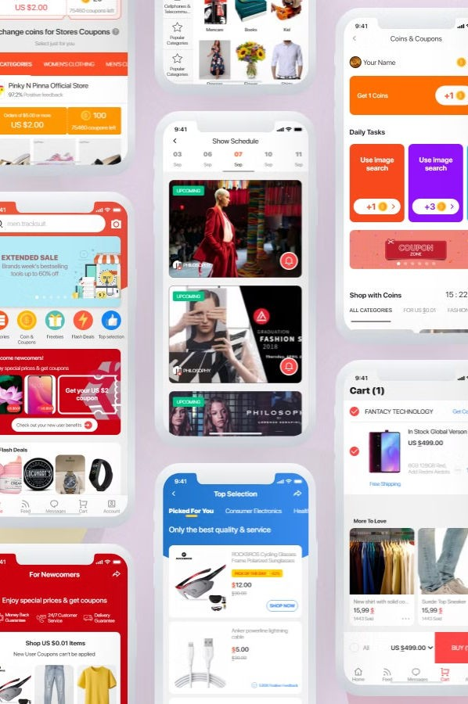
User Interface Design
The app's clean and modern design makes it easy to explore categories, search for products, and access your account. High-quality product images and vibrant graphics create an engaging and visually stunning shopping experience. Smooth transitions, responsive gestures, and real- time updates ensure a delightful and efficient user experience.

Slide 12
Backend Architecture
Scalable Infrastructure - The app's backend is built on a robust and scalable cloud-based architecture, ensuring reliable performance and seamless handling of high traffic volumes.
Efficient Data Management - A powerful database system and data processing pipelines enable real-time product updates, inventory tracking, and personalized recommendations.
Microservices-based Design - The modular, microservices-based architecture allows for independent development, testing, and deployment of the app's various functionalities.

Slide 13
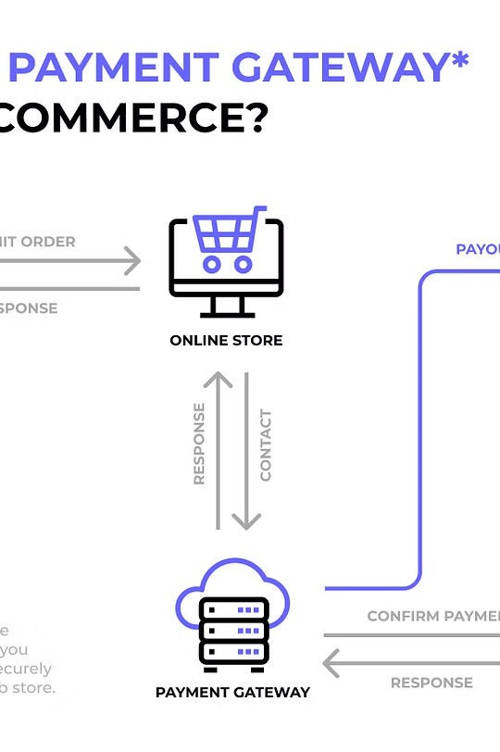
Integration with Payment Gateways
Seamless integration with major credit card providers for a secure and convenient checkout experience. Support for popular mobile payment solutions, including Apple Pay, Google Pay, and Samsung Pay. Option to pay with cryptocurrencies, providing an additional layer of flexibility and security.

Slide 14
Scalability and Performance
Elastic Scaling
The app's infrastructure automatically scales up or down based on fluctuating user demand, ensuring optimal performance at all times.
Caching and CDN
Leveraging content delivery networks and caching mechanisms to minimize response times and improve page load speeds.
Load Balancing
Intelligent load balancing distributes incoming traffic across multiple servers, preventing bottlenecks and maintaining high availability.

Slide 15
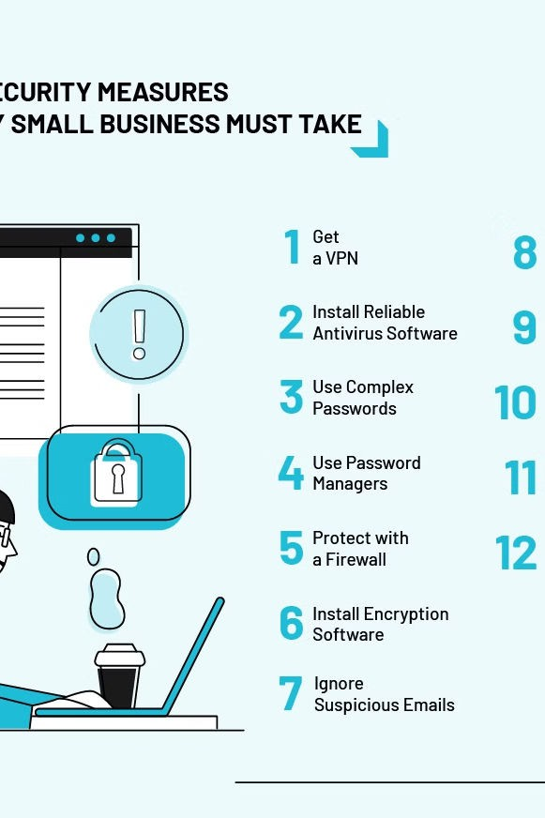
Security Measures
Encryption
All sensitive user data and transactions are protected with industry- standard encryption protocols, ensuring the privacy of customer information.
Multi-factor Authentication
Robust authentication methods, including biometrics and one-time passwords, provide an additional layer of security for user accounts.
Vulnerability Monitoring
Continuous security monitoring and regular penetration testing help identify and address any potential vulnerabilities in the app's infrastructure.

Slide 16
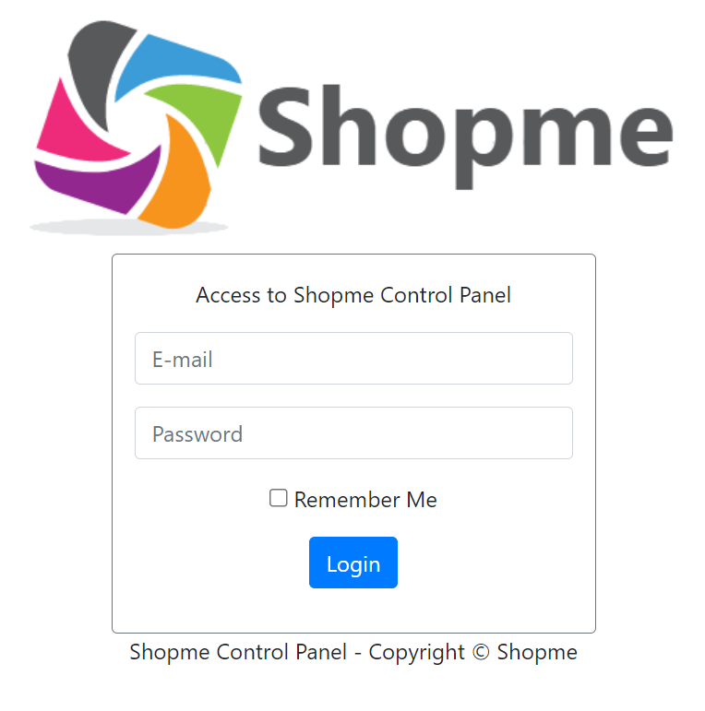
LOGIN FORM
The login feature in ShopMe not only ensures secure access but also lays the foundation for personalized and seamless shopping experiences, fostering customer satisfaction and loyalty. The login feature provides secure user authentication, ensuring that only authorized users can access the ShopMe platform. Users are required to enter their credentials, typically a username/email and password, to authenticate their identity.

Slide 17
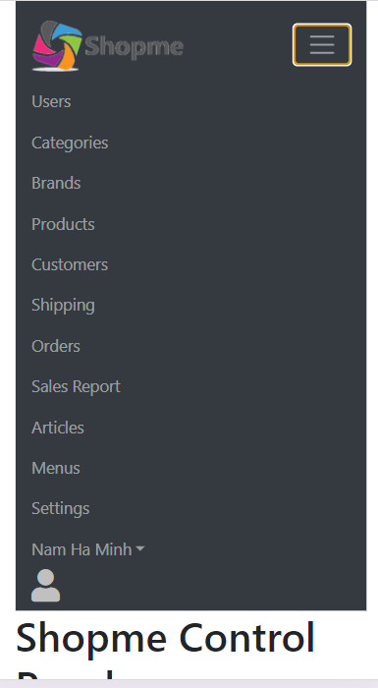
HOMEPAGE
After successfully logging in to ShopMe, users are greeted with the Home Page, serving as the central hub for accessing various features and content. The Home Page is designed with a user-centric approach, prioritizing easy navigation and intuitive access to essential functionalities. ShopMe showcases a diverse range of categories, including electronics, fashion, home decor, and more, prominently on the home page.

Slide 18
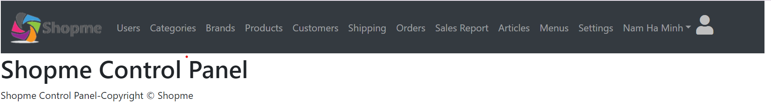
Navigation Bar in shopme
ShopMe's navigation bar is designed to provide users with quick and convenient access to essential features and content.
User-Centric Navigation: The navigation bar is designed with the user in mind, making it easy to find and access the features they need.
Category Exploration: The "Category" option in the navigation bar allows users to explore a wide range of product categories, including electronics, fashion, home decor, and more.
Brand Selection: Users can easily navigate to the "Brands" section to discover products from their favorite brands or explore new brands available on ShopMe's platform.

Slide 19
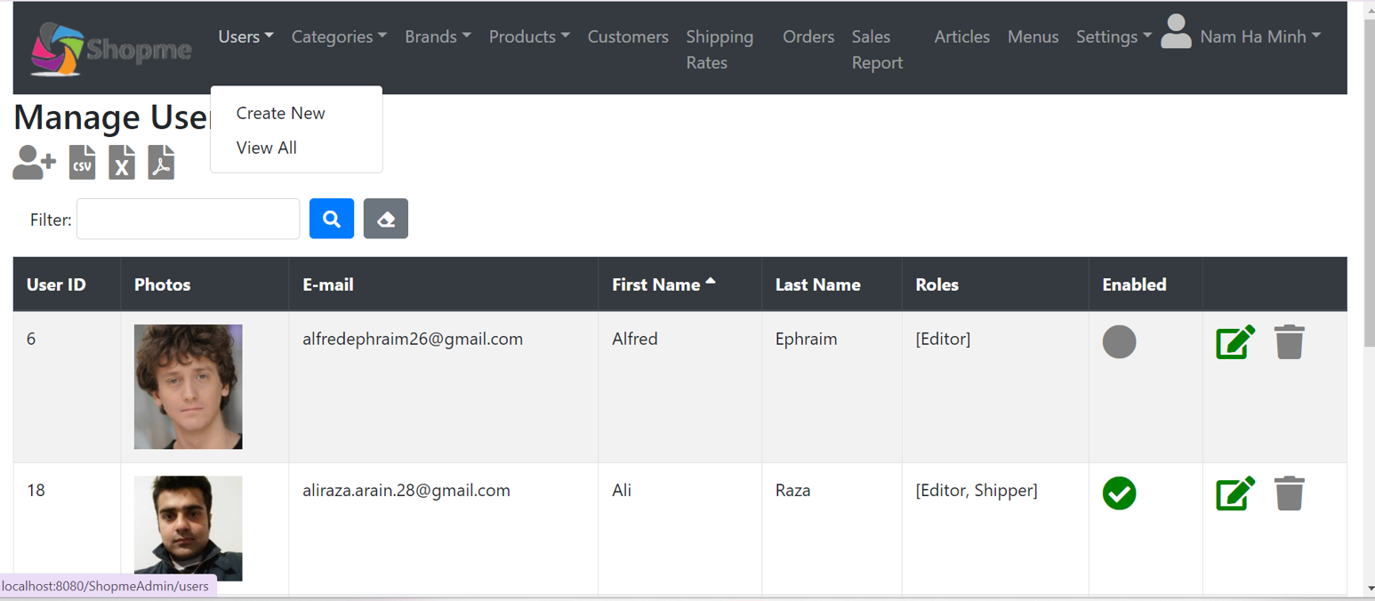
User Category Management
"Create New"
The "Create New" option allows users to fill out a registration form to add details for a new user account.
"View All"
The "View All" option presents a list of all existing users for easy management and oversight of the user database.

Slide 20
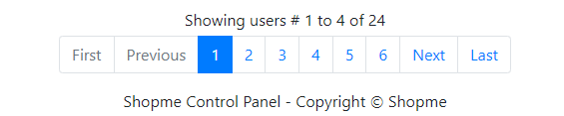
Pagination and Sorting
At the bottom of the page, there is pagination and sorting functionality for the rows based on fields.

Slide 21
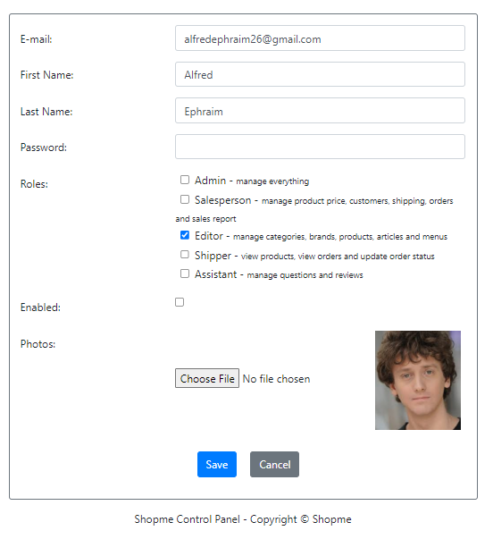
Edit User Template
The user editing template in ShopMe allows administrators to modify user account details and settings. This comprehensive interface enables seamless management of user information, permissions, and account status.
Key features of the edit user template include the ability to update personal details, contact information, and login credentials. Administrators can also adjust user roles and access levels to ensure appropriate permissions are granted.
Additionally, the template provides options to deactivate user accounts or reset passwords as needed, maintaining tight control over the user database.

Slide 22
User Category Management
User Creation: The "Create New" option allows users to fill out a registration form to add details for a new user account.
User Listing: The "View All" option presents a list of all existing users for easy management and oversight of the user database.
Data Export: ShopMe facilitates exporting user data in formats such as CSV, Excel, and PDF, enabling users to analyze or maintain records externally.
Management Features: Within the user listing, users can manage accounts by editing details, adjusting permissions, and deactivating accounts as necessary.

Slide 23
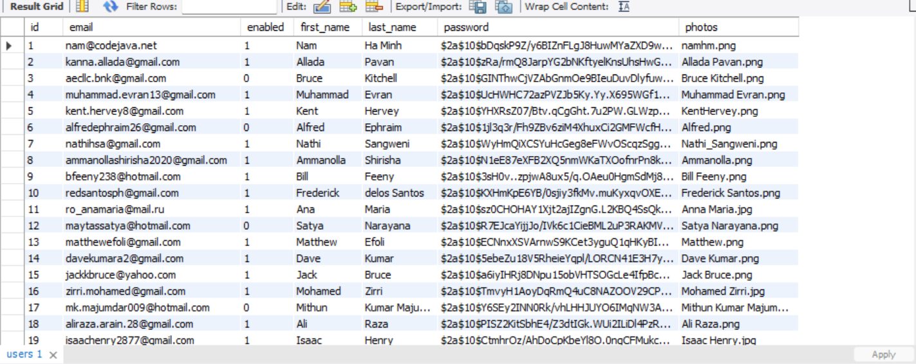
User Data Management in SQL Database
ShopMe utilizes a relational database management system (RDBMS) such as MySQL to store user data securely and efficiently. ShopMe ensures data security by employing, and compliance with data protection regulations.
encryption techniques for sensitive information, access controls to manage user permissions

Slide 24
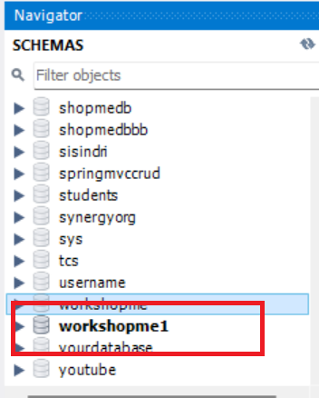
DATABASE CREATION
Define the database schema and tables to store user data, product information, order details, and other relevant business data.
Implement secure data storage practices, such as encryption for sensitive fields, access controls, and compliance with data protection regulations.
Optimize the database design for efficient querying, data retrieval, and scalability to handle the growing needs of the ShopMe platform.

Slide 25
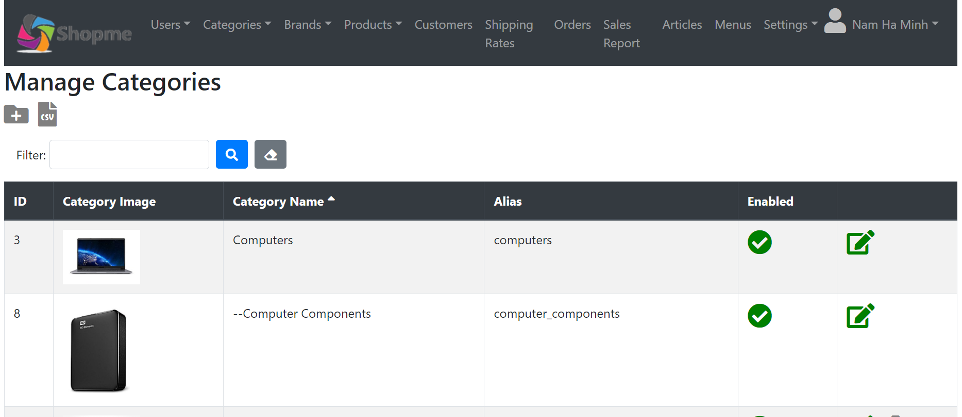
Category Management in ShopMe
Each category in ShopMe is represented by a set of attributes stored in the database. These attributes include a unique ID to identify the category, a Category Image to enhance the visual appeal, and a Category Name that provides a descriptive name for the category. Additionally, categories can have an Alias, which is an alternate name or label for the category. To support administrative control, ShopMe also provides Enable, Edit, and Delete Options to enable or disable categories, as well as edit and delete them as needed.

Slide 26

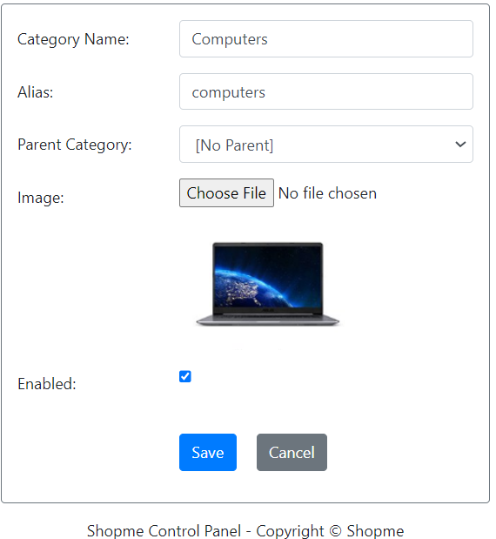
Edit option:
Here we can edit the content which we need to change.

Slide 27
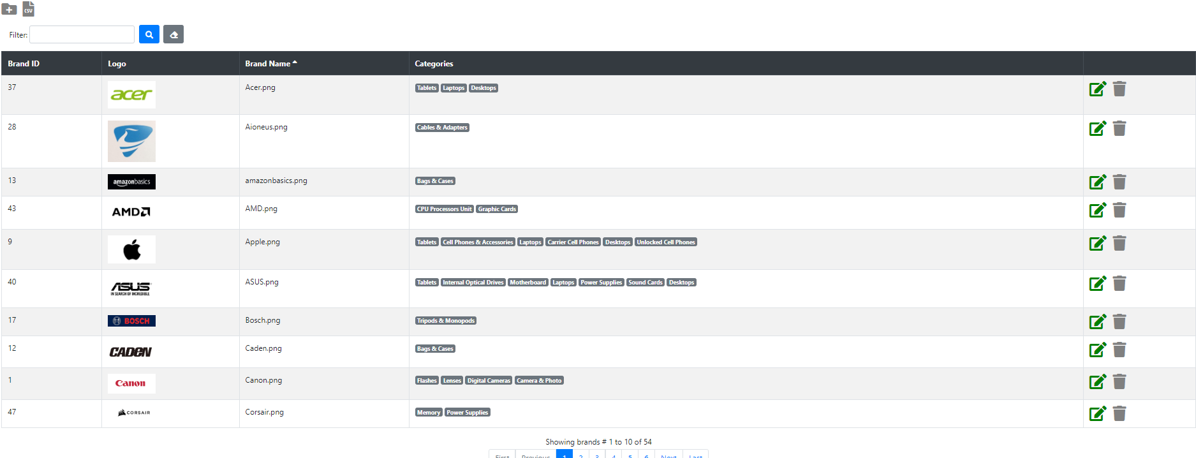
Brand Management in ShopMe
ShopMe's brand management system is designed to provide a comprehensive and organized approach to managing the various brands featured on the platform. Each brand in ShopMe is characterized by specific attributes stored in the database, including a unique Brand ID to identify the brand, a Logo to visually represent the brand, and the Brand Name that officially identifies the brand. To further facilitate organization and navigation, each brand is also associated with a Category that the brand belongs to.
To ensure administrative control over the brands, ShopMe offers Enable, Edit, and Delete Options that allow authorized users to enable or disable brands, as well as edit and delete them as needed. This functionality empowers the platform's administrators to maintain a curated and up-to-date selection of brands, ensuring a seamless and engaging shopping experience for customers.

Slide 28
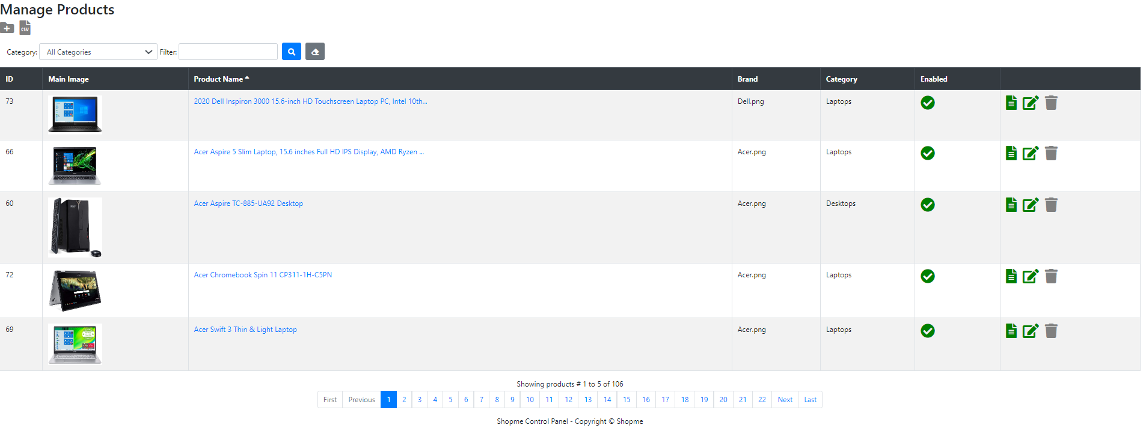
Product Management in ShopMe
Each product in ShopMe is characterized by key attributes stored in the database. These attributes include a unique ID to identify the product, a Main Image to provide a visual representation of the product and attract users, and a Product Name that offers a descriptive name identifying the product. Additionally, each product is associated with a Brand for brand recognition, and a Category to which the product belongs, aiding in classification and organization.
To ensure administrative control over the products, ShopMe offers Enable, Edit, and Delete Options that allow authorized users to enable or disable products, as well as edit and delete them as needed. This functionality empowers the platform's administrators to maintain a curated and up-to-date selection of products, ensuring a seamless and engaging shopping experience for customers.

Slide 29
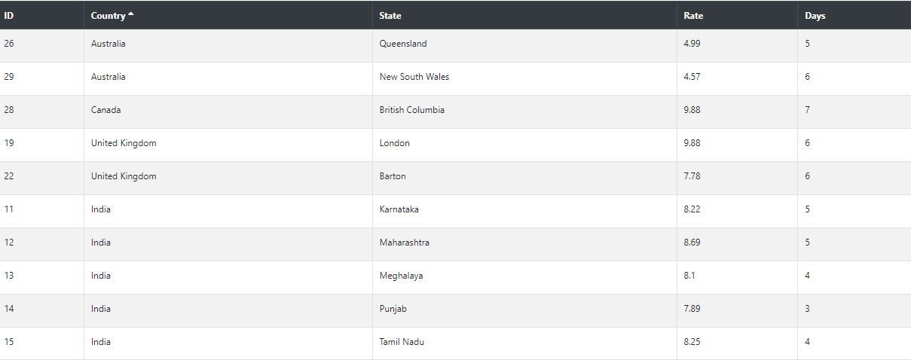
Reviews & Rating:
ShopMe provides a robust reviews and rating system that allows customers to share their experiences with products and services. This feedback mechanism is crucial for building trust, improving product quality, and enhancing the overall shopping experience on the platform.
Customers can leave detailed reviews, including ratings, comments, and even photos or videos showcasing the product. These reviews are then displayed on the product page, giving potential buyers valuable insights into the real-world performance and quality of the items they are considering purchasing.
ShopMe's review system also includes features for managing and moderating reviews, such as the ability to respond to customer feedback, flag inappropriate content, and analyze review trends over time. This helps the platform's administrators maintain a high-quality, trustworthy, and transparent review ecosystem.

Slide 30
Order Management in ShopMe
ShopMe's order management system is designed to provide a comprehensive and efficient way to handle customer orders. Each order in ShopMe is defined by essential attributes stored in the database, including a unique ID to identify the order, the Customer associated with the order, providing customer details for order fulfillment, and the Total amount of the order, including product prices, taxes, and shipping costs.
The Order Time attribute indicates when the order was placed, aiding in order processing and tracking. The Destination attribute stores the shipping address for delivering the order to the customer, and the Payment Method reflects the method used by the customer to pay for the order, such as credit card, PayPal, or cash on delivery.

Slide 31
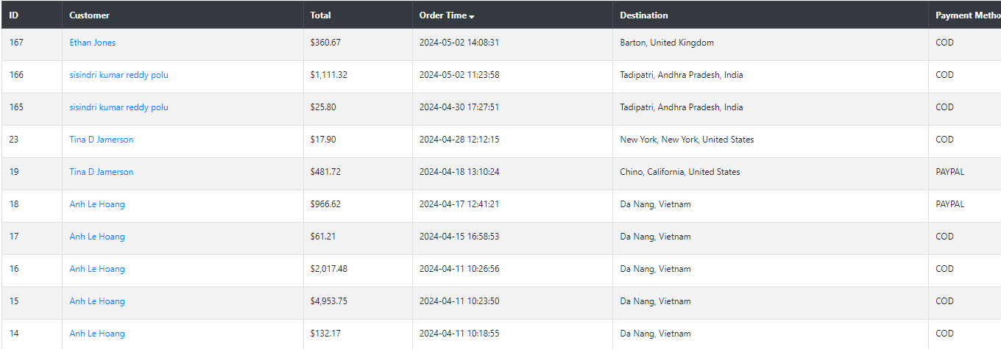
Order Management in ShopMe
To manage the order lifecycle, ShopMe also tracks the Status of each order, indicating whether it is pending, confirmed, shipped, or delivered. This comprehensive order management system ensures efficient order processing, accurate tracking, and a seamless customer experience throughout the order fulfillment process.

Slide 32
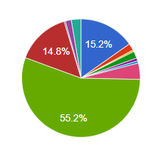
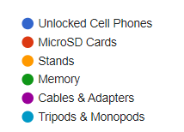
Sales Reports in ShopMe
Sales by Date
Visualizes sales data over time, allowing users to identify patterns, seasonal trends, and fluctuations in sales volume.
Sales by Category
Breaks down sales figures by product categories, highlighting top-performing categories and areas for growth or improvement.
Sales by Product
Provides insights into product performance, indicating best-selling products, slow-moving items, and opportunities for optimization.

Slide 33
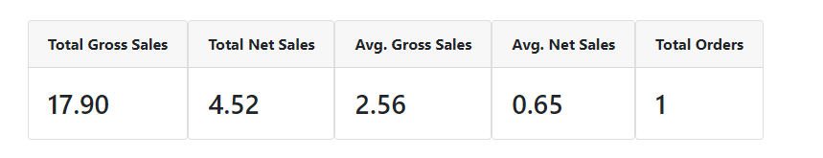
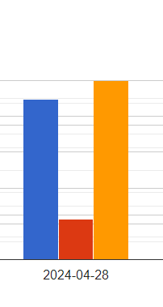

Sales Reports in ShopMe
Sales by Date
Visualizes sales data over time, allowing users to identify patterns, seasonal trends, and fluctuations in sales volume.
Sales by Category
Breaks down sales figures by product categories, highlighting top-performing categories and areas for growth or improvement.
Sales by Product
Provides insights into product performance, indicating best- selling products, slow-moving items, and opportunities for optimization.

Slide 34
Key Metrics
ShopMe calculates essential metrics to evaluate sales performance and profitability:

Slide 35
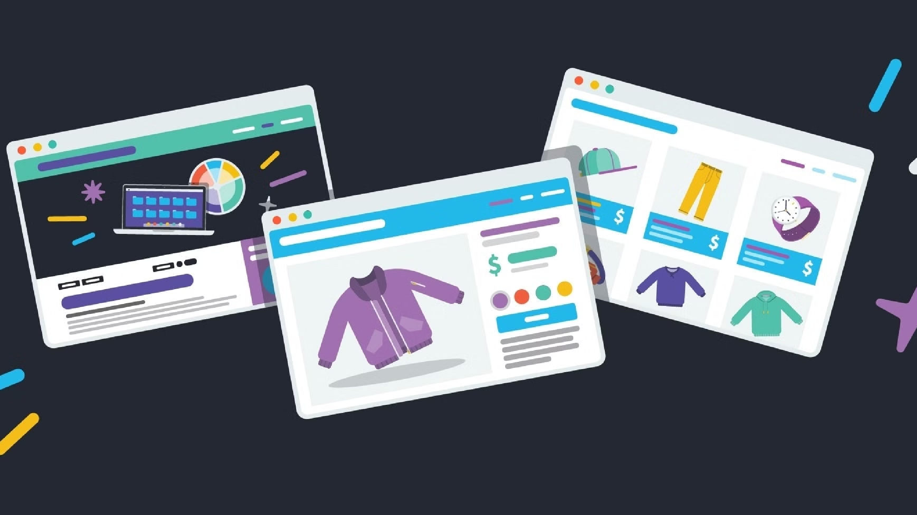
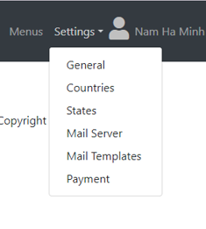
Settings in ShopMe
Payment Integration
Seamlessly integrate payment gateways like PayPal and Stripe, configuring settings for secure transactions and refund policies.
Configuration
Customize general settings, manage countries and states, and configure mail server settings for transactional emails.
Email Templates
Utilize pre-designed templates or customize emails for order confirmations, notifications, and password resets.

Slide 36
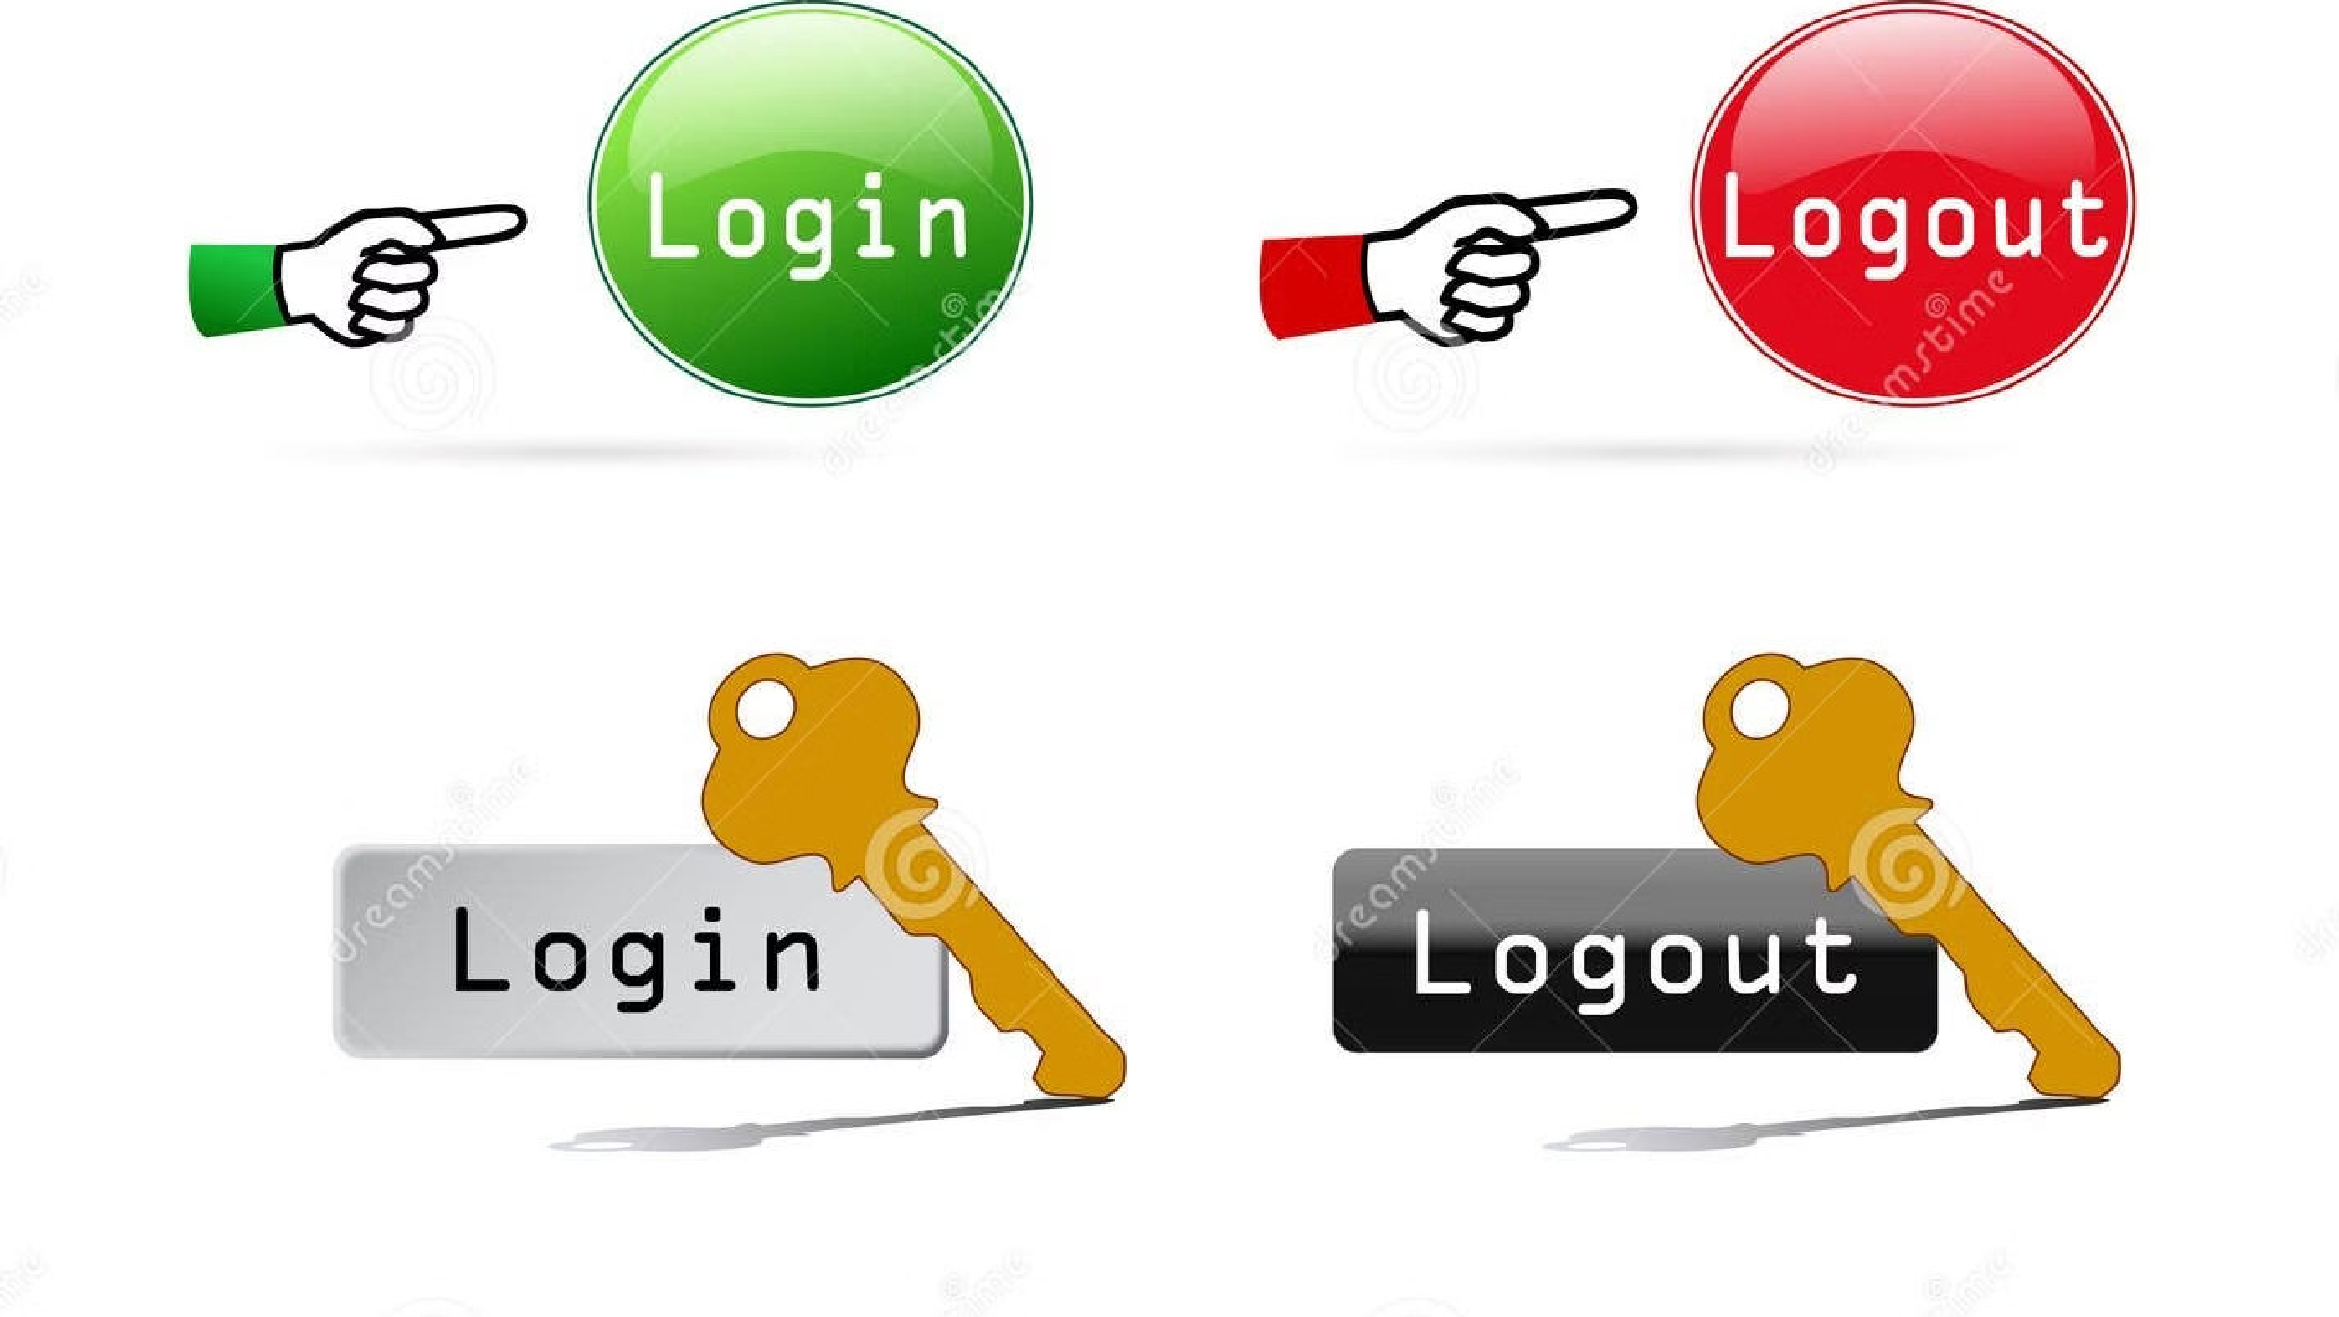
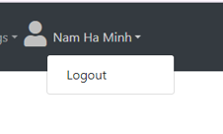
User Login and Logout
Secure Access: Users log in securely with credentials, granting access to ShopMe's features.
Session Management: ShopMe manages sessions for seamless access and security, expiring inactive sessions.
Simple Logout: Users can logout easily, terminating sessions and ensuring security.

Slide 37




Technologies Used
T
Back-end
The ShopMe application is built using Java, Spring MVC, Spring Boot, and Spring Security as the core back-end technologies.
Front-end
The front-end of ShopMe utilizes Thymeleaf and Bootstrap to create a responsive and visually appealing user interface.
Database
The application's data is stored in a MySQL database, providing a reliable and scalable data storage solution.
Development Tool
The ShopMe team uses IntelliJ IDEA, a powerful and feature- rich Integrated Development Environment (IDE), to streamline the development process.

Slide 38

Android mobile view:
The ShopMe application provides a seamless and responsive mobile experience for Android users. The intuitive interface and optimized design ensure easy navigation and access to key features on-the-go.

Slide 39

Video Experience Across Android, iOS, and Desktop
The ShopMe application provides a seamless and engaging video experience across multiple platforms, including Android, iOS, and desktop.
Users can enjoy high-quality product demonstrations, tutorials, and brand content optimized for their device and screen size.
The responsive design and adaptive streaming capabilities ensure a consistent and enjoyable viewing experience, whether accessing ShopMe on- the-go or from the comfort of a desktop computer.

Slide 40
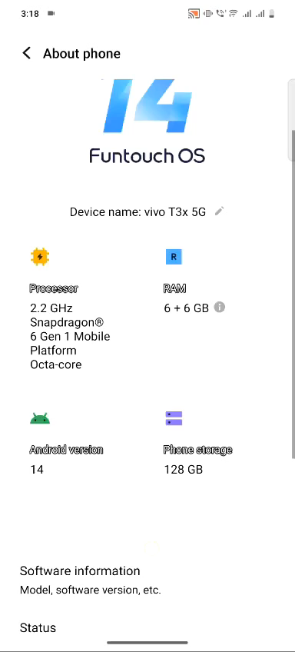
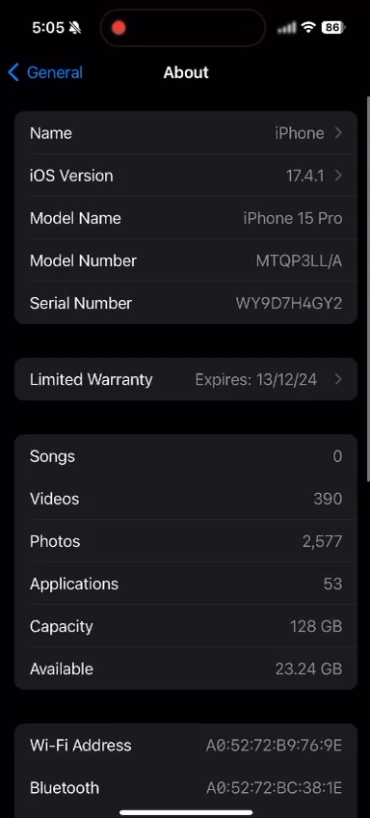

Slide 41


